Slide 1
Progress report
Siti Nurafifah Bte Md Rusli
Alice Yap

Slide 2
Agenda
What have we learned?
What have we done/problems encountered?
Conclusion

Slide 3
What have we learned?
R language : a programming language and software environment for statistical computing and graphics
Plot graphs
Analyse and extract real data (Data Analysis)
Relationship between data

Slide 4
Github
What is github?
A web-based Git repository hosting service, which offers all of the distributed revision control and source code management (SCM) functionality of Git as well as adding its own features.
What’s so special about github?
Version control :
A system that records changes to a file or set of files over time so that you can recall specific versions later

Slide 5
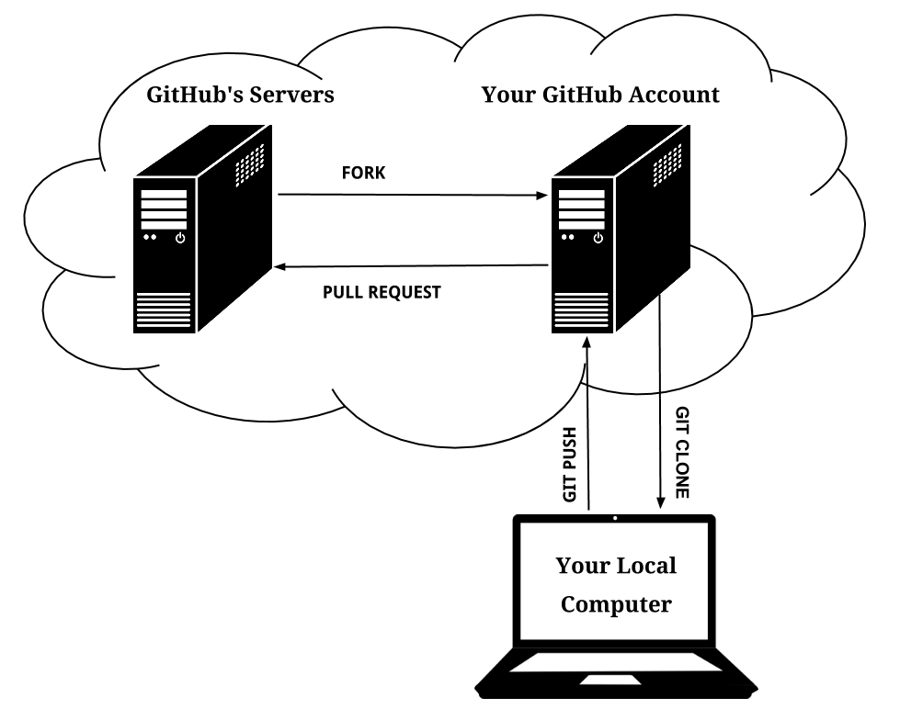
Github-push and pull

Slide 6
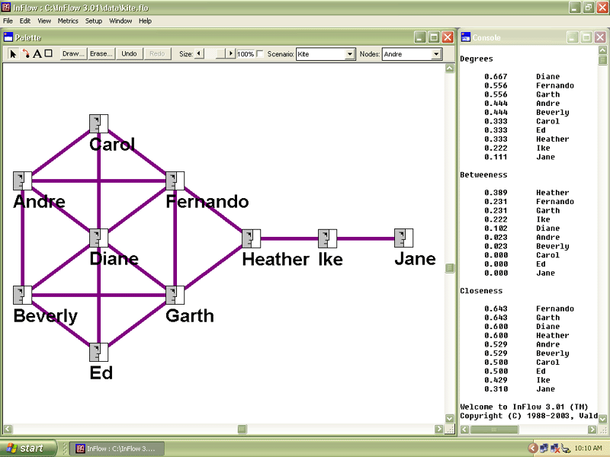
Introduction to Social Network Analysis
Social network analysis [SNA] is the mapping and measuring of relationships and flows between people, groups, organizations, computers, URLs, and other connected information/knowledge entities.
Related software: Pajek
What is Pajek?
A computer program used to
analyse and visualize large
networks.

Slide 7
Starting of Project
A historical dataset for the Gnome Ecosystem:
-Study the evolution of social aspect of the Gnome ecosystem(1,418 projects, 11,094 contributors, 1,315,997 commits)

Slide 8
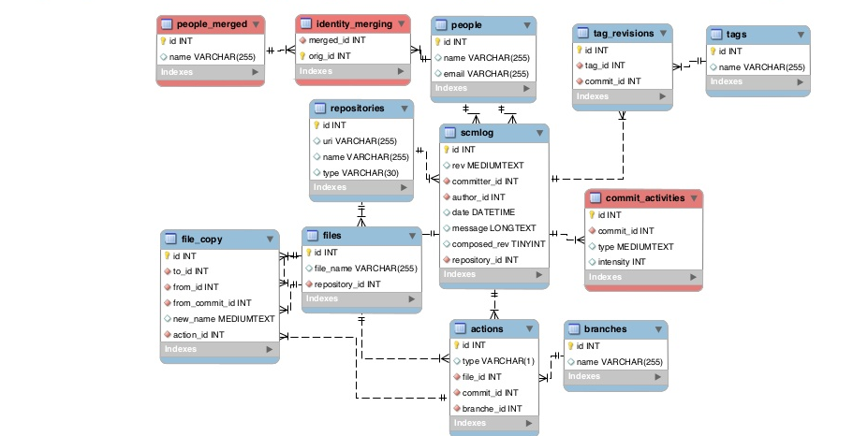
About the dataset
FLOSSMetrics MySQL database:
https://bitbucket.org/mgoeminne/sgl-ﬂossmetric-dbmerge

Slide 9
Starting the project(Repo-pre-Analysis)
Our task:
Generate csv file across the attributes selected.
Generate histogram and boxplot of the number of commits for each repository
Generate histogram and boxplot of the number of committers for each repository
Generate histogram and boxplot of the number of authors for each repository
Generate histogram and boxplot of the number of files for each repository

Slide 10
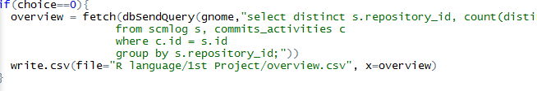
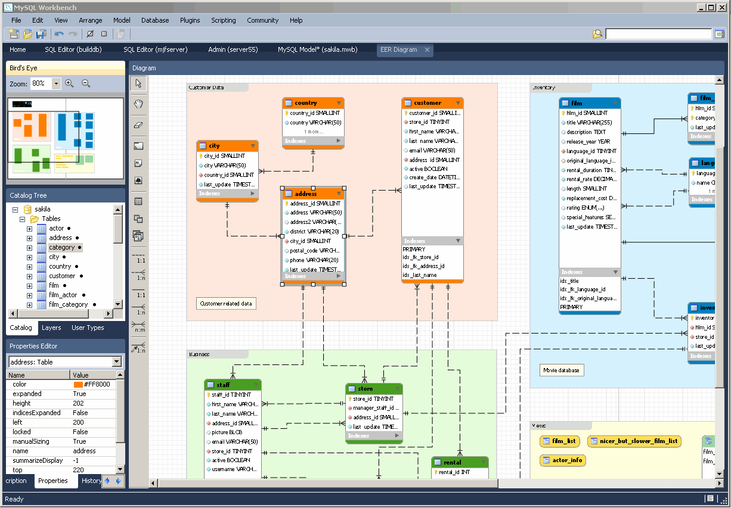
Accessing MySQL through R
MySQL workbench

Slide 11
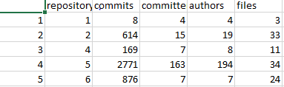
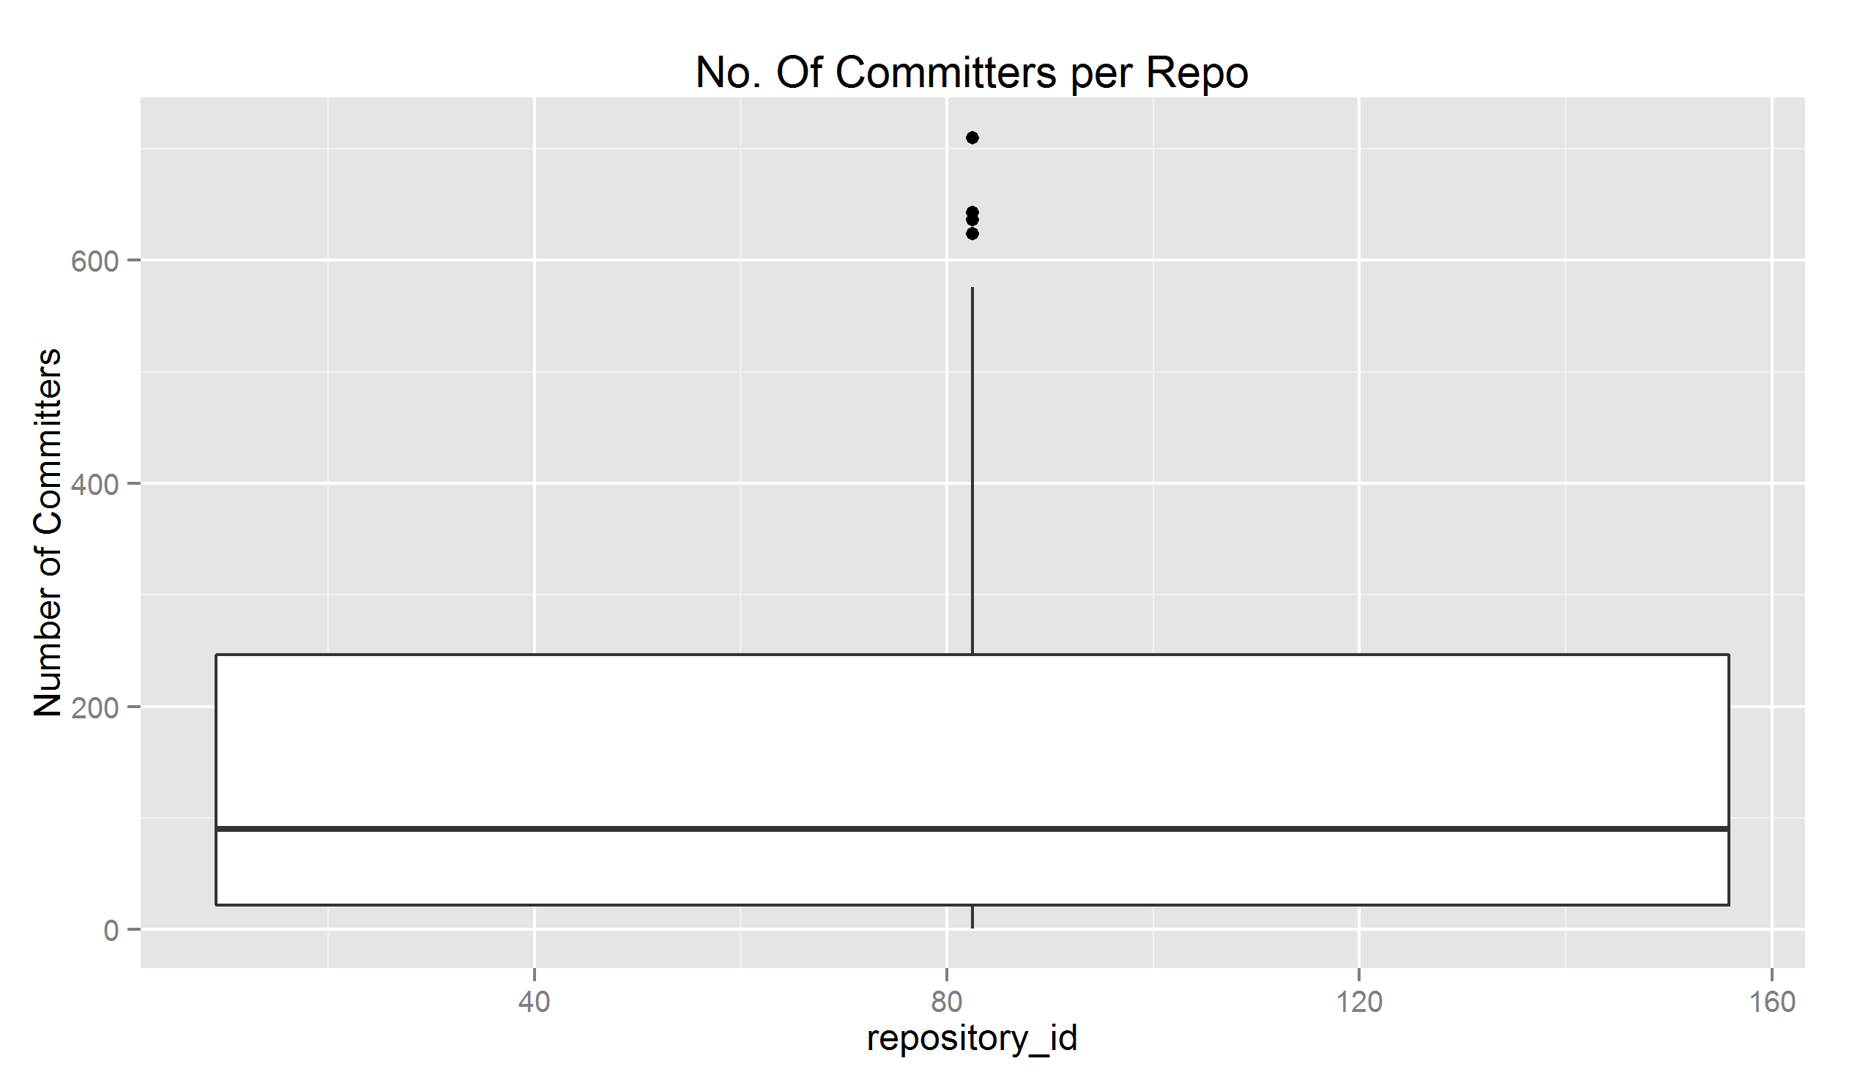
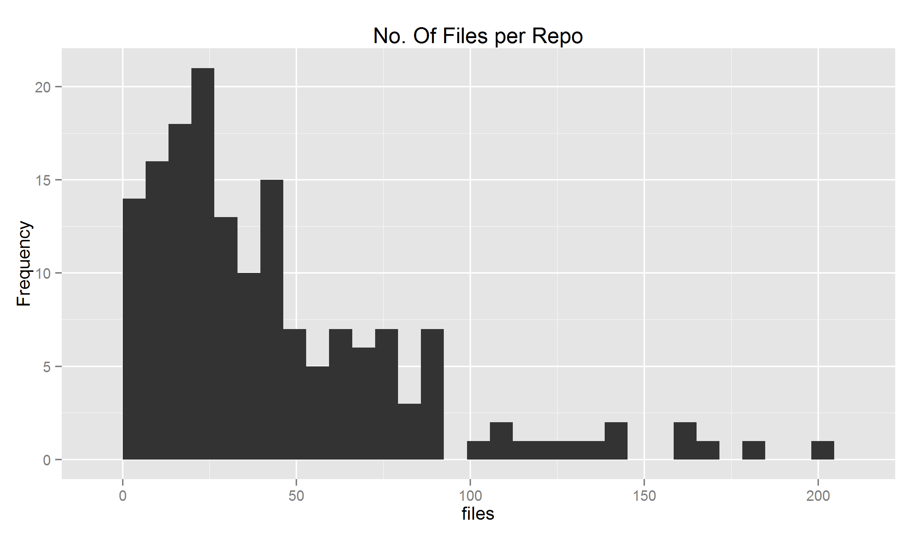
CSV files
BoxPlot
Histogram

Slide 12
Starting of Project(People-pre-analysis)
Generate csv file across the attributes selected.
Generate histogram and boxplot of the number of times each person is the committer
Generate histogram and boxplot of the number of times each person is the author
Generate histogram and boxplot of the number of different repositories each person has committed to
Generate histogram and boxplot of the number of different repositories each person has authored commits to

Slide 13
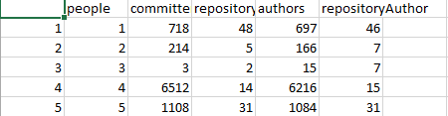
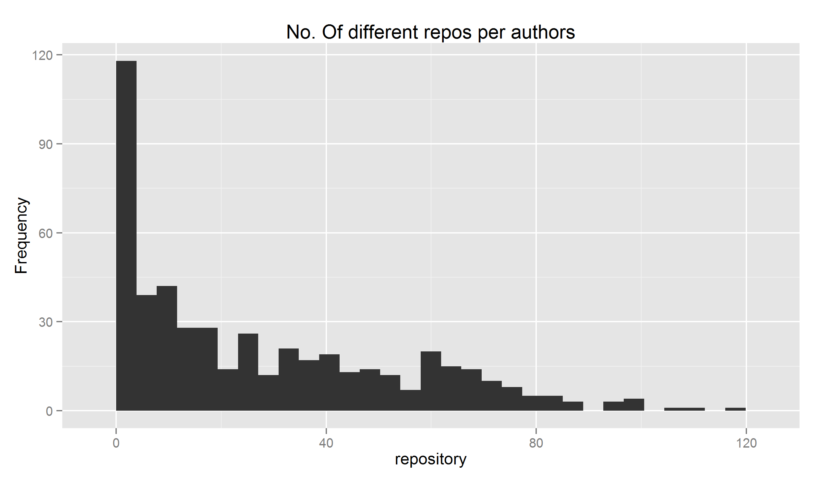
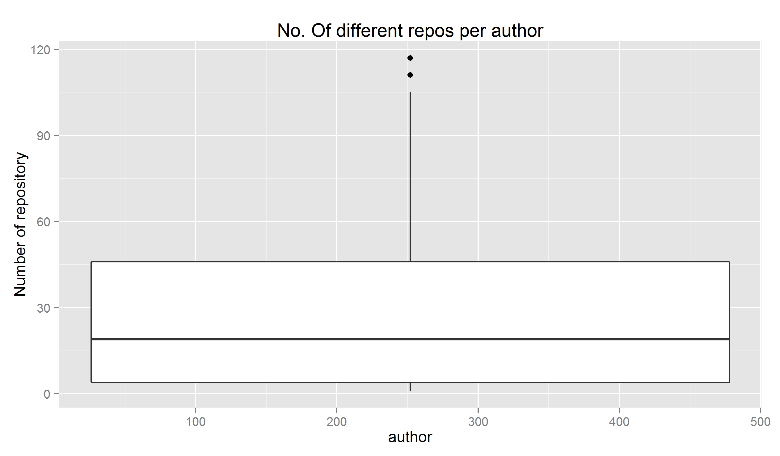
CSV File
Histogram
BoxPlot

Slide 14
Problems Encountered
Unable to identify the tables from the data set given.
Unable to fetch the query
How do we solve them?
Cross verify by pulling out specific data and compare to the results from our general query
Trial and error
Google

Slide 15
Conclusion
What's next for us?
Data Analysis:
- Hypothesis
- Draw networks

Slide 16
Reference
https://www.dropbox.com/s/9n2hclfg76dx5dv/gnome_db.sql.bz2?dl=0
http://www.maelick.net/media/files/papers/msr13-gnome-dataset.pdf

